Slide 1


SMART INDIA HACKATHON 2018
TEAM NAME : Vibe
TEAM ID : 20249
TEAM LEADER : Saakshi Srivastava
TEAM MEMBERS : Siddhau Jain
Sree Aslesh Penisetty
Ankit Kumar Singh
Pamireddy Sucharitha
Dhriti Kumari

Slide 2

Automated Parcel Sorting Using OCR & PTL Solution

Slide 3
Current scenario in India Post
According to the India Post survey, India has the largest postal network in the world with over 1,54,882 Post offices of which 89% of offices are in rural areas and there is no standard operating procedure for sorting of letters, postal cards, small parcels, voluminous parcels etc.
Currently, India post has a modernized automatic mail processing system, which can sort 20,000 letters or small parcels per hour but still in rural areas, sorting of letters are done manually.
These automatic mail processing facilities are provided in the main hubs of Delhi and Kolkata only according to the survey of 2012.
But barcodes are scanned and are sorted further, manually for larger or voluminous parcels like books, electronic items etc.

Slide 4
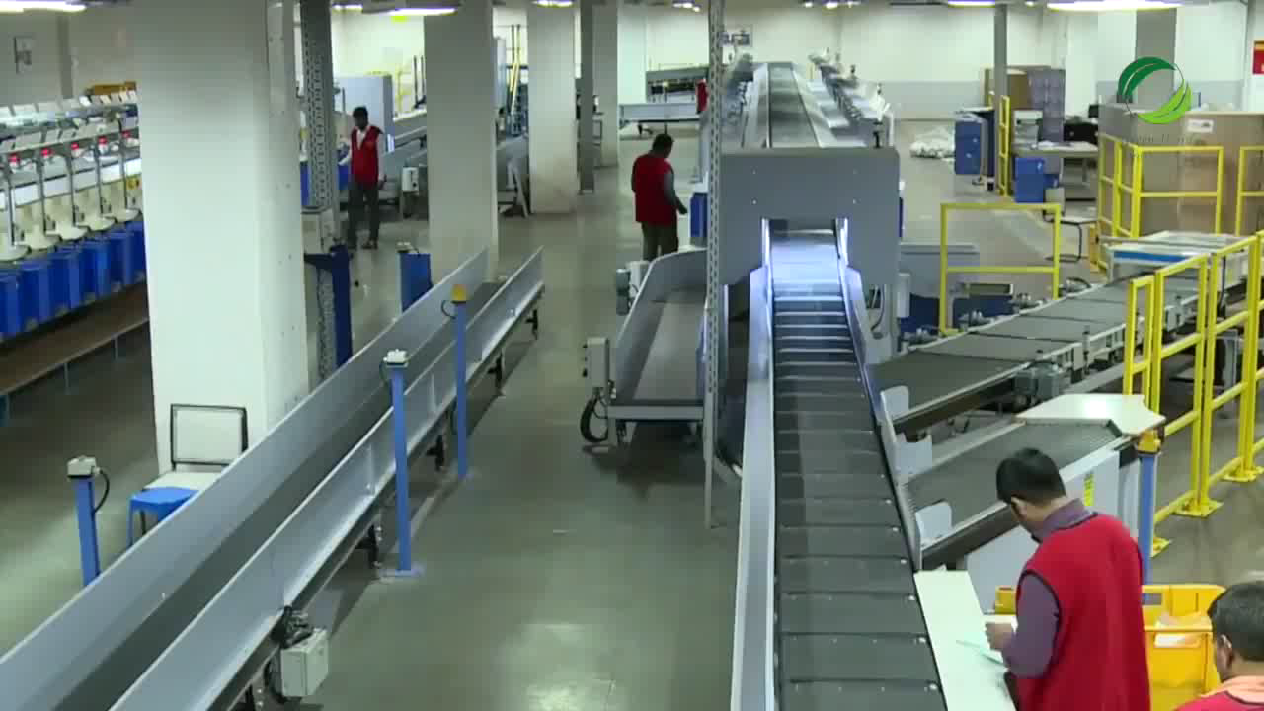
A glimpse of how parcel sorting is done manually in India Post
Inference from the video :
Using method of manual sorting
Definite need of skilled labour
Possibility of human error

Slide 5
Problem Statement
The existing parcel sorting happens manually either on floor area or on conveyor belt.
The entire parcel sorting does not have any Standard Operating Procedure which brings down the sorting efficiency.
At the primary sort level, articles are sorted into groups of range of pin codes to be sorted further
( secondary sort ) and bagged for destination
hubs.
But currently, secondary sort requires a skilled
labour to find the correct destination bag.

Slide 6
How sorted parcels are checked ?
There are three levels to this :
Initial Sorting is done by a sorting assistant
Then it is verified by a senior sorting assistant
And for a final check it goes to the Head sorting assistant
Even after going through such a rigorous process of checking for the correct sort of the parcel there is a small and even considerate possibility of human error.

Slide 7
How many parcels could be wrongly sorted with a chance of 0.1% chance of human error ?
According to some workers in India Post parcel hubs
sorters sort 800 letters in a shift of 8 hours.
Considering, at least 0.1% of error by 1 sorter, then, number of parcels getting sorted wrong = | 800*0.001= .8
Considering, at least 50 sorters in a postal hub, then, Total number of parcels getting sorted wrong= | .8*50= 40 parcels (out of 50*800= 40,000 parcels)

Slide 8
Cost estimate in Present Scenario
In India we have around 1.5 lakh post offices out of which 89% are in rural areas. Employment is a factor which cannot be ignored in any step towards innovation and development.
Approximate monthly salary of a worker in a governmental postal hub = Rs.30,000
Approximate annual salary of one worker in a governmental postal hub= Rs.3,60,000

Slide 9
Considering such a possibility of error we have two ways to choose from, which would improve the sorting efficiency 1. Semi-automated sorting using PTL solution and unskilled labor. 2. Complete automation of the sorting mechanism.
We will go into the details, benefits and systematic evaluation of both the mechanisms

Slide 10
Automated sorting mechanism

Slide 11
Goals and Objectives of automated solution
To eliminate the human operated mechanism for parcel sorting system.
To improve the delivery time.
To reduce manual error.
To maximize productivity and efficiency in minimum cost.

Slide 12
Role of automation in sorting mechanism
Primary Sorting : In this phase of the sorting the OCR (Optical Character Recognition) is used to read the barcode and get data about the parcel from the pre existing database.
Secondary sorting : In this the automation is done using a box based sorting mechanism. There are series of flaps which actuate based on where the parcel is supposed to go.

Slide 13
Flow of action implemented
Enter sorting process
Fetch data
from database
Parcel
with barcode
Barcode Scanner
Database
Communication with Arduino
Parcel Sorted
Parcel falls into vertical column
Setting of Selector Flaps

Slide 14
Description of the secondary sorting mechanism
Zone 1
Zone2
Zone 3
Zone 4
The alignment of the stacks of boxes are as shown.
This is a mechanism which is expandable to any number of zones which we would like to sort the boxes into.
There are flaps on each zone box which act as selectors as to where the parcel has to go into.
This mechanism minimizes the space constrain of the current sorting mechanism used.
Zone 5
Zone 6
(as in the prototype)

Slide 15
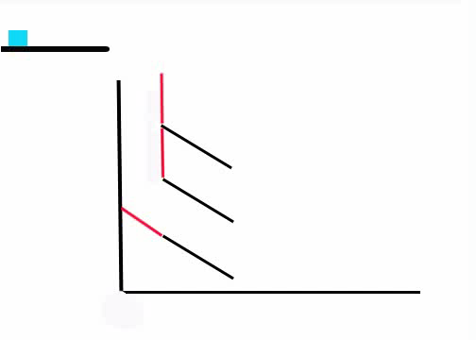
Example of the sorting mechanism

Slide 16
Benefits of Automated Parcel Sorting
According to the Department of Post, 40 lakh parcels will be handled by the India Post in near future, implying automation is needed.
Increasing customer satisfaction, in terms of handling and delivery timing of parcels
Reducing manual error
Improving productivity and efficiency

Slide 17
Cost estimation of finished automated machine
Component | Quantity | Total Price (in Rs.)
Arduino Mega | 1 | 1000 x 1 = 1000
Seven Segment Display | 6 | 15 x 6 = 90
Motor Driver | 3 | 200 x 3 = 600
Light Indicator | 6 | 50 x 6 = 300
High torque Servo motor | 5 | 900 x 5 = 4500
Camera cum Barcode Scanner | 1 | 10,000 x 1 = 10,000
IR sensor | 6 | 200 x 6 = 1200
Decoder IC | 6 | 12 x 6 = 72
Total cost of automated machine = Rs. 17,762

Slide 18
Cost estimation (continued)
Approximate cost of raw materials(wood casing, metal sheets, clamps etc.) = Rs. 10,000
Cost of automated machine = Rs. 17,762
Approximate Power supply per month for 24 hours functioning = Rs. 8,000 Approximate maintenance charges per month = Rs. 5,000
Approximate expenditure on the mechanism per month = Rs. 13,000
One-time investment cost = Rs. 27,762

Slide 19
Economic estimate per month

Slide 20
Semi – Manual Parcel Sorting using PTL solution

Slide 21
Goals and Objectives of semi-manual sorting
Employment opportunity for unskilled labor in the village areas
Give the rural citizens of India a chance at a secure living
Cost effective for the government
Time efficient as to reduces the time required for sorting
Reduces percentage of human error increasing the over all efficiency of the process.

Slide 22
Flow of action implemented
Enter parcel sorting process
Barcode Scanner
Database
Communication with Arduino
Parcel sorted
LED of the baggage turns ON
Selection of destination baggage

Slide 23
Description of secondary sorting mechanism
The secondary sorting mechanism is implemented here with the help of PTL solution which can be emphasized as “Put To Light ” Solution.
Put to Light solution is an effective way to reduce cost of implementation and running the mechanism .
It works on the basis that when the barcode is read , it checks for the destination and based on the destination it will glow a light based on which the bag has to be placed in.

Slide 24
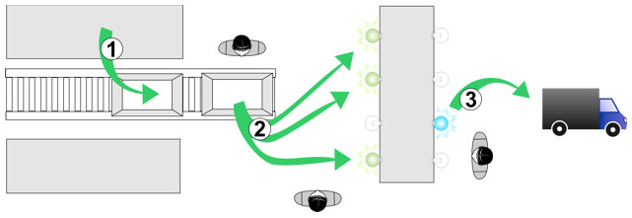
What is PTL ?
The PTL solution is usually employed for order assortment, product consolidation, tracking, traceability, kitting, product assembly, replenishment, packaging, validation, and slotting, among others.
When products arrive at the assortment zones, their barcode is scanned, thus illuminating the corresponding displays and providing an exact instruction of where should the product be placed.
Operators immediately confirm the operation. An inventory control is provided, which allows identifying the order status; all of this in real time. Additionally, this control identifies the time needed for completion regarding the productivity currently handled by the system.

Slide 25
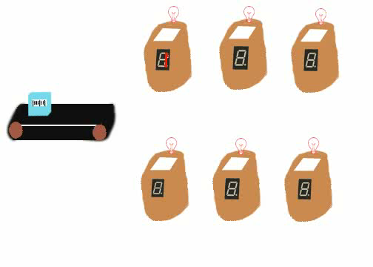
Mechanism of PTL Solution

Slide 26
Benefits of Semi-Manual Sorting mechanism
Employment opportunity for unskilled labor in the village areas
Give the rural citizens of India a chance at a secure living
Cost effective for the government
Time efficient as to reduces the time required for sorting
Low maintenance cost
Reduces percentage of human error.
Easy to use

Slide 27

Woman empowerment in the rural areas
Empowerment is a multi-faceted, multi-dimensional and multi-layered concept.
Women's empowerment is a process in which women gain greater share of control over resources - material, human and intellectual and control over decision-making in the home, community, society and nation, and to gain `power'.
There is a very important problem on the rise which is empowerment of under privileged women.
The work of unskilled labors here is rather easy while also providing a safe and secure working opportunity.

Slide 28
Cost estimation of semi-automated machine
Components | Quantity | Price (in Rs.)
Light Indicators | 6 | 50 x 6 = 300
Seven Segment Display | 6 | 50 x 6 = 300
Decoder IC | 3 | 12 x 3 = 36
Microcontroller | 1 | 1000 x 1 = 1000
Total estimated cost of semi-automated machine = Rs. 1,636

Slide 29
Cost estimation (continued)
Approximate cost of semi-automated machine = Rs. 1,636
Approximate cost of power supply ( DC source) per month = Rs. 1,000
Approximate cost of raw materials(wood casings, clamps etc.) = Rs. 500
Approximate maintenance cost = Rs. 1,000
Installation cost = Machine cost + Raw materials cost + Power supply cost = Rs. 1,636 + 1,000 + 500 = Rs. 3,136

Slide 30
Technology Stack
Scripting Language : Python
Database API : MongoDB
Barcode Scanner : Barcode Scanning Software based on Optical Character Recognition
Microcontroller : Arduino, used to control devices involved in automation

Slide 31
Components Used
Camera cum Barcode Reader
Arduino
DC motor
Light Emitting Diodes (LEDs)
Seven Segment display
Decoder IC
Motor Drivers

Slide 32
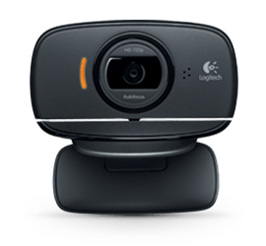
Camera cum Barcode Reader
Reads and scans barcode placed on the parcels for further decoding and fetching of data from the database for secondary sorting.
Specifications:
360-degree full motion rotation camera
Smooth auto-focus
Auto light correction for dim and harsh lighting

Slide 33
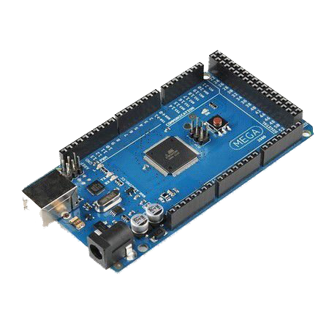
Arduino Mega
Microcontroller board to control devices involved in automation
The Mega 2560 is a microcontroller board based on the ATmega2560.
It has 54 digital input/output pins (of which 15 can be used as PWM outputs), 16 analog inputs, 4 UARTs (hardware serial ports), a 16 MHz crystal oscillator, a USB connection, a power jack, an ICSP header, and a reset button.
It contains everything needed to support the microcontroller; simply connect it to a computer with a USB cable or power it with a AC-to-DC adapter or battery to get started.
The Mega 2560 board is compatible with most shields designed for the Uno and the former boards Duemilanove or Diecimila.
Specifications:
256 KB flash memory

Slide 34
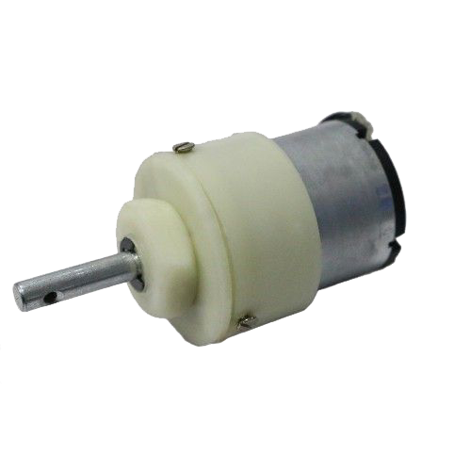
DC motor
It is used to operate the flaps in the automated solution
However, a servomotor may be used instead as it has more accuracy and angle precision.
Specifications:
12 V
100 rpm
300 mA

Slide 35
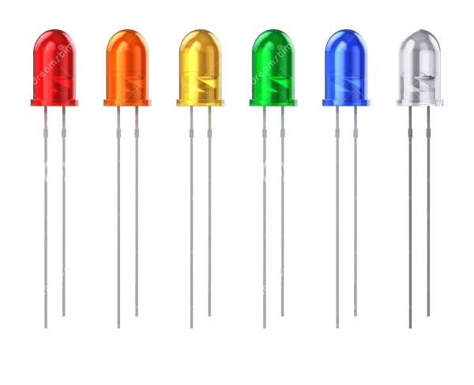
Light Emitting Diodes (LEDs)
It is a semi conductor device that emits light when electric current is passed through it.
Used to indicate the baggage to which the current parcel belongs to.
It is turned ON when a signal is passed through Arduino that the baggage is recognized as the destination bag for the parcel.

Slide 36
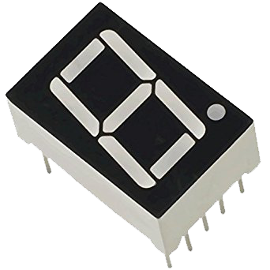
Seven Segment Display
Acts as a “counter” to count the number of parcels a destination baggage is carrying.
Resets the counter once the number of parcels dropped exceed seven.

Slide 37
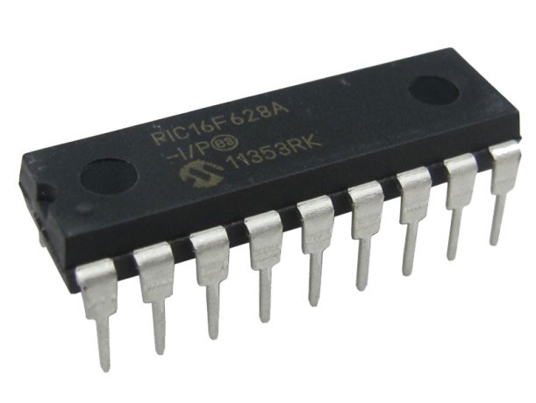
Decoder IC
HT12D is a decoder integrated circuit that belongs to 2¹² series of decoders. This series of decoders are mainly used for remote control system applications, like burglar alarm, car door controller, security system etc.
It is mainly provided to interface RF and infrared circuits. They are paired with 2¹² series of encoders. The chosen pair of encoder/decoder should have same number of addresses and data format.
In simple terms, HT12D converts the serial input into parallel outputs. It decodes the serial addresses and data received by, say, an RF receiver, into parallel data and sends them to output data pins.

Slide 38
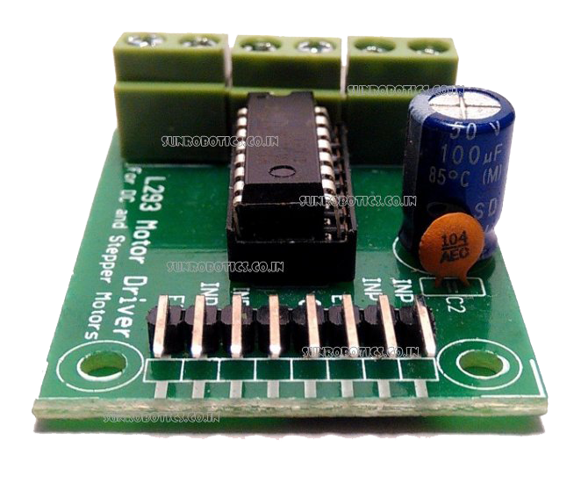
Motor Driver (L293D)
It is a H-Bridge motor driver working on simple MOSFET switches to run the motor in both the direction.
A capacitor is usually put in between the VCC and ground to avoid the power fluctuations.
Specifications:
It is a current amplifier and is used by any device, like motor that draws current more than 50-100 mA
It is a 16 pin IC which has the capacity to drive two individual motors.
The IC is powered by a +5V VCC while it has the capacity to run a motor with voltage rating of +12V DC.

Slide 39
References
https://www.indiapost.gov.in/VAS/DOP_PDFFiles/Post_AR_English_2017-18.pdf
https://www.indiapost.gov.in/VAS/Pages/AboutUs/PostOfficeNetwork.aspx
http://www.tanay.co.in/blog/amazon-starts-using-india-post-and-screws-its-delivery-system-india.html
https://tech.economictimes.indiatimes.com/news/internet/india-post-to-invest-rs-322-crore-to-augment-parcel-capacity/50896256

Slide 40
THANK YOU ☺

